Slide 1
ACHIEVING WATER SECURITY AND IMPROVE WATER GOVERNANCE
February 27-28, 2020
NEGROS FIRST HOSTEL
BACOLOD CITY
ENGR. SUSAN P. ABAÑO
Chief, Policy and Program Division
National Water Resources Board

Slide 2
Presentation Outline
Achieving Water Security
- Water Governance (Issues and Challenges)
- Balancing Water Supply and Demand towards
Long Term Security (Bacolod and surrounding
areas)
- Role of NWRB
3

Slide 3
ACHIEVING Water Security
Water Governance Issues and Challenges:
Multiplicity of Water Related Institutions and their fragmentation
Policy Making
NEDA
Coordination / Regulation
NWRB
Water Quality & Sanitation
Watershed
Management
Integrated Area
Development
Data
Collection
Flood
Management
EMB DOH
BRL EHS
LGUs MWSS
LWUA-WDs
FMB BSWM
NIA NPC
PAWB
LGUs
LLDA RDCs
BOI PEZA
RBCO
NWRB BRS
NAMRIA LWUA
MGB PAGASA MWSS NIA
DPWH-PMO
OCD-NDCC
PAGASA
MMDA
Water Supply
Irrigation
Hydro Power
NAPC-WASCO
DOF-CDA
DBP DAR
DPWH MWSS
LWUA-WDs
PTA HUDCC
DILG-PMO
PEZA LGUs
DOST-PCAFNRRD
ERDB
Cloud Seeding
NIA DA
BSWM
DOE PSALM
NPC PEMC
PAF BSWM
3

Slide 4
ACHIEVING Water Security
Water Governance Issues and Challenges
Overlapping Institutional Mandates/Conflicting Laws and Policy Issuances resulting to weak management framework and planning
- Water Code of the Philippines (PD1067)
- Local Government Code of the Philippines
(RA 7160)
- Provincial Water Utilities Act of 1973 (PD 198)
- NIPAS Act of 1992 (RA 7586 of 1992)
- Philippine Clean Water Act (RA 9275)
- Other policy issuances
3

Slide 5
ACHIEVING Water Security
Water Governance Issues and Challenges
Inadequate Data and Information for Integrated Water Resources Management and policy analysis due to low priority for data monitoring and management system
3

Slide 6
ACHIEVING Water Security
Balancing Water Supply and Demand
Water Supply Management (an adaptive approach in response to rising demand for water )
- Explore, Develop and adopt new eco-
efficient water infrastructure towards water
sustainability
* rainwater harvesting
* water recycling
* water desalination
* wastewater reuse
* flood water reuse, etc.
3

Slide 7
ACHIEVING Water Security
Balancing Water Supply and Demand
Water Demand Management (innovative techniques , develop habits to conserve water, improve water use efficiency and address water shortage and wasteful use of water )
* use of water efficient technology (fixtures,
plumbing, etc.)
* water saving irrigation technology (sprinkle
irrigation, etc.)
* intensify water education campaign
* intensify research and development of
efficient technologies
* others
3

Slide 8
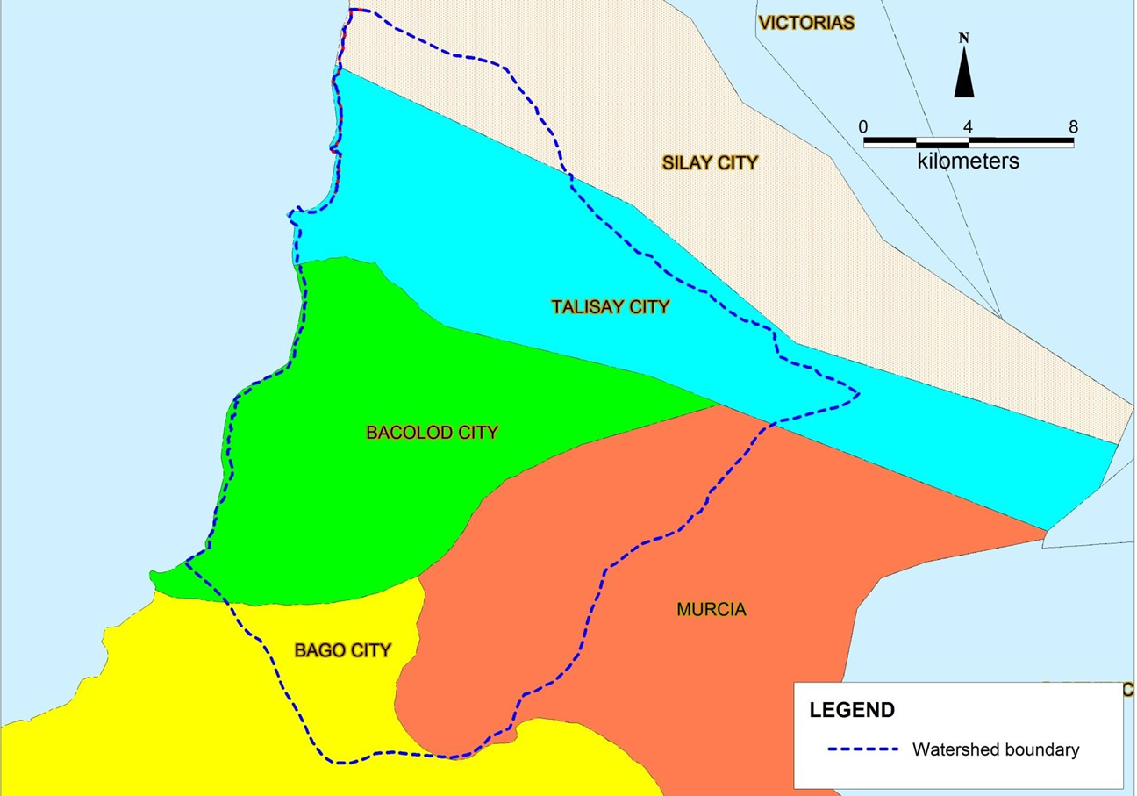
ACHIEVING Water Security
Balancing Water Supply and Demand (Bacolod City and Surrounding Areas)
3

Slide 9
ACHIEVING Water Security
Balancing Water Supply and Demand (Bacolod City and surrounding areas)
Issues on groundwater
Groundwater deficit of 5 million liters per day in Bacolod City
Over extraction of aquifers
Proliferation of unregistered wells
Salt water intrusion
Aquifer contamination
3

Slide 10
Major Water Providers in the Study Area
Water Providers | No of Operational Wells | Tapped Springs | Estimated Daily Production (m³) | Primary Water Use
Bacolod City Water District | 50 | 2 | 57,703 (Wells) 9,302 (Spring) | Domestic
Talisay City Water District | 12 |  | 7,679 | Domestic
Murcia Water District | 0 | 2 | 2,492 | Domestic
CC FEMSA Phils. Inc. | 3 |  | 1,200 | Industrial
Tanduay Distillers, Inc. | 4 |  | 3,600 | Industrial
Pepsi Cola Products Philippines Inc. | 2 |  | 600 | Industrial
SMBI Bacolod Brewery | 3 |  | 1,200 | Industrial
Camella, | 1 |  | 300 | Domestic
Forest Hills Subdivision | 1 |  | 300 | Domestic
Grandville Subdivision | 3 |  | 1,200 | Domestic
Sta. Fe. Resort | 1 |  | 500 | Domestic
Hillside Subdivision | 1 |  | 300 | Domestic
Pearl Homes | 3 |  | 900 | Domestic
Fiesta Homes | 3 |  | 900 | Domestic
Kool Company Inc. | 3 |  | 600 | Industrial
Total | 90 | 4 | 88,775 | 8

Slide 11
Plot of Major Wells and Springs showing LGU boundaries¹⁶

Slide 12
Aquifer | Groundwater Potential |  | Total GW Potential
 | MCM/ year | lps | MCM/ year | lps
Upper Aquifer | 67.97 | 2,155.38 | 87.70 | 2,781.03
Lower Aquifer | 19.73 | 625.65
Amount currently being extracted from the Lower Aquifer by the NWRB permitted wells is 857.43 lps already exceeds the estimated groundwater potential of 625.65 lpd of the said aquifer.

Slide 13
Section along the middle slopes of Mt. Mandalagan highlights the undulating nature of the hydrogeological layers

Slide 14
Ground Water Quality within Study Area
Water extracted by major water providers from Lower Aquifer essentially passed PNSDW.
Lower Aquifer naturally protected from contamination from
the surface by the Aquitard
Water extracted from shallow wells tapping the Upper Aquifer used mainly for washing, others can still be used for drinking.
Upper Aquifer vulnerable to contamination from the
surface

Slide 15
Map of Potentially Salt-intruded Area

Slide 16
Plot of major wells with respect to potentially salt Intruded areas

Slide 17
Results of Isotope Studies
Water Quality
Aquifer | Sampling Station | Tritium Concentration
 | Surface water, rainfall | 1.5 Tritium units
Upper Aquifer | Springs, shallow well | 1.5 Tritium units
Lower Aquifer | Feliza Well Field | 0 – 0.5 Tritium Units
Low tritium concentrations indicate older water; water from Lower Aquifer

Slide 18
Result of the Study:
At current extraction rates, piezometric level of the
Lower Aquifer will continue to decline
Decline could go be below sea level which increases risk of salt water contamination particularly for major wells near the coastal area
Drilling of additional wells which will tap the Lower
Aquifer is not recommended
Additional wells may be drilled to tap the Upper Aquifer at the middle to upper slopes of Mt. Mandalagan

Slide 19
Strategies
Watershed wide regulation of GW Extraction
Development of other water sources
Resource Management and Conservation
Watershed wide surface water and groundwater quality protection
Improvement of groundwater management through appropriate policies based from science based studies

Slide 20
Strategies
Management of Recharge Areas
The protected status of Mt. Mandalagan must be strictly maintained and monitored.
Development at the upper slopes of Mt. Mandalagan must be restricted.
These slopes should be the focus of current efforts of
revegetation/reforestation

Slide 21
Constructed groundwater Monitoring Wells as of 2019
Well Designation | Locality | Depth (m) | 2018 Static Water Level (m) | 2019 Static Water Level (m) | Aquifer
TM1 | Acacia Well Area, Talisay | 110 | 3.36 | 5.19 | Lower
BM1 | Jovito Sayson National High School | 150 | 27.34 | 27.57 | Lower
BM2 | Vista Allegre Elementary School | 150 | 17.15 | 17.95 | Lower
BM3 | Emilio Lizarde National High School | 130 | 14.99 | 17.20 | Lower
BM4 | Jayme Elementary School | 15static 0 | 31.32 | 32.19 | Lower

Slide 22
ACHIEVING Water Security
ROLE OF NWRB
Continue with the Water Resources Assessment programs prioritizing on fully allocated aquifer (groundwater) and rivers (surface water)
Continue constructing groundwater monitoring wells and installation of telemetry for automatic data collection or manual data collection
3

Slide 23
ACHIEVING Water Security
ROLE OF NWRB
Based from the Groundwater Management Plan Study, NWRB can formulate specific policies for groundwater management in Bacolod City and surrounding areas.
LGUs can also approve specific ordinances for groundwater management in collaboration with NWRB and other water related agencies
3

Slide 24
ACHIEVING Water Security
ROLE OF NWRB
Coordination with the LGUs on the monitoring and enforcement of the Water Code of the Philippines (ordinances)
- submission of data and registration
should be part of the business permit
renewal during the first quarter
- Inventory/inspection of all existing
water users in their respective barangay
or municipalities
- closing of wells without water permit
3

Slide 25
ACHIEVING Water Security
ROLE OF NWRB
Sustain the Listahang Tubig Water Registry to come up with appropriate policy to improve and expand water service delivery
Support the Creation of the Department of Water Resources and Water Regulatory Commission
Continue to support research and development for water resources assessment
3

Slide 26
ACHIEVING Water Security
ROLE OF NWRB
Continue to conduct Water Education Campaign on Water Conservation
Continue partnership with the LGUs, NGAs and the academe in implementation of projects for the water sector
Continue to implement the PDP 2017-2022 for sustainable development and integrated management of the water resources
3

Slide 27
Water is a shared responsibility thank you

